Slide 1
MISA – MRM V2
Integrated Technical Review (ITR)
July 21, 2010 (Version 4)

Slide 2
Agenda
Review Scope and Objectives of the ITR
Better understand Business User needs for performance analysis requirements
Review revised MRM V2 Model
  MISA Delivery Platform
  Governance and Role review
Summarize Tool Assessment
  Rational (Reqpro based)
  IBM Smart Architecture and Engineering model (Eclipse, RSx, UML based)
  System Architect and Focal Point
  Cognos and SPSS
  Collaboration & Repository (Quickr)
Demo System Architect and Focal Point Strategic Enterprise Planning demo
Next Steps

Slide 3
Integrated Technical Review (ITR) Approach
  Business Direction/Drivers
    Review original RFI and the subsequent IBVA
    Determine stakeholder roles and objectives
      MISA
      IBM (e.g. MISA plug-in options within IBM tools)
      MISA Subscribers (municipalities)
  Review Functional Requirements Matrix
    Municipal Reference Model (MRM), V2-Rel 1 Business Use Cases, Tasks, Operations, Features and Meta Model Specifications (Draft V19, Dec 2009)
    Best Practice/Assets types
  Assess Use Case (s) and solution options
    IBVA Business Use Cases (approx. 5)
    System Use Cases / Task Specifications (approx. 21)
    Other?
  Understand other requirements and activity
    Scripting and reporting needs
    Non-Functional requirements
    Standards
  Address Pilot and Tool Concerns documented
    June 25, 2010 email including SDW Technical Challenges document and MRMv2 Functional and Technical Requirements document

Slide 4
Objectives - Coherent Government by design
If we really want:
  to move to a “whole of government” approach,
  seamless, citizen-centred services,
  legislation, regulations and policies designed rather than crafted,
  alignment, integration, interoperability, etc. in our business systems,
  to do more with less
We really need:
  a consistent and more formal business design capability based on a common language and set of rules for using it to create better descriptions of what we want (e.g. more coherent ones). A pan-Canadian standard along these lines will enable any conceivable government line-of-business (and inter-collaborations thereof) to better:
    interpret and clarify their missions, strategies, outcomes, etc.
    accurately depict or map how they work (and how they can work together),
    discover opportunities for business improvements,
    support their planning and successful implementation.

Slide 5






Evolve
Before
Defaults to
Paper
Assets
Business & Users
Implementation
Pictures & Documents
Fund
Hand off
Requirements
Governed
Confusion
Leverage
tools aligned
to a Roles
usability
& integration
needs
After
Business & Users
Business Architecture
Implementation
Impact Analysis
Fund
Publish
Requirements
Governed,
Managed Assets
Acceleration!
Code, Scripts,
Traceability,
Accuracy
Instrumented (KPIs) Interconnected (traceability) Intelligent (acceleration!)

Slide 6
The Municipal Reference Model Version 2 (MRM v2)
MRM v2 Goal: to create a Tool (Product, Service) that will help municipal governments describe their vision, goals, objectives, programs, services and performance metrics.
…in a standard way
…using precise definitions and concepts accepted and adopted by all governments in Canada
…with tools and templates to help you create the descriptions of the municipality
…with user guides and training material to help create and use these descriptions for a range of municipal purposes
…with a repository where these descriptions can be saved
…repository pre-populated with a generic set of service descriptions that may be provided to any municipality in Canada
…repository pre-populated with specific descriptions (models) created by other municipalities
…with tools that allow for the analysis and comparison of such descriptions
…and with a collaboration space that allows ideas to be shared on how these tools are being used in participating municipalities
In short: A powerful Authoritative Service Catalogue aligned to an Authoritative Meta Model that all Municipalities can use and share.

Slide 7
Original Strategy to support Model Driven Business / IT Strategy and Design
(Re-) Use & Develop Models
Business Analyst
Service/Data
Analyst
Service/Data
Designer
Integration/Data
Developer
Define Project Scope
Business
Drivers
IBM Industry Models
(Plug-ins to
IBM Modeling & Design
Tools based on open standards)
Analyze Processes
Analyze Services
Design Services
Design Processes
Analyze Data
Define Logical Data Model
Define Physical Data Models
Define Datastores
Govern & Manage Enterprise Model Development
Propagate Enterprise Models
(Re-) Use & Develop Models
Harvest Project Models
Identify and Validate Changes
Version Enterprise Models
Model
Manager
Govern & Manage Enterprise Model Assets
Asset
Manager
Govern & Manage Model Development
Promote Enterprise Model
Publish Model Assets
Publish Derivative Assets

Slide 8

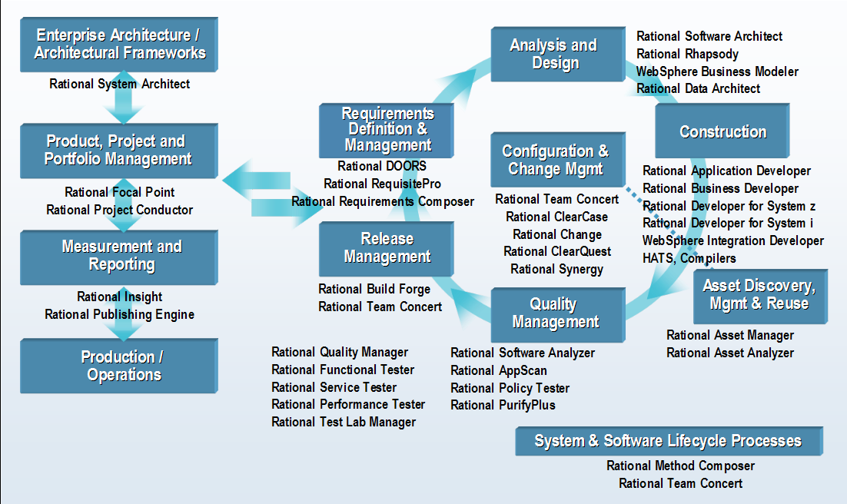
Direction from 2008: Integrate selected RSx products
Note: Rational Software Modeler (RSM) is a subset of Rational Software Architect (RSA)

Slide 9











ITR validated and further detailed the functional roles that will develop use of the MRMv2 definitions and measures in each municipality, based on a common metamodel and definitions
Information Technology
Budgeting & Finance
Workforce/ HR
Mission Performance
Financial Performance
Operational Performance
Executive Management
Supply Chain
Operations/ Readiness
Services Delivery
Program Execution

Slide 10
ITR surfaced additional needs for measurement and reporting, and stronger ties between program and service planning with operational management and analysis
1
Business Intelligence
2
Financial Performance & Strategy Management
3
Advanced Analytics
4
Analytic Applications
Monitoring & measuring mission performance to ensure the best outcomes.
Financial and operational performance tied to attaining mission objectives.
Predictive models, forecasting & “what-if” scenarios for refining finance and operations to deliver mission objectives.
Analytic applications developed for specific functions to better manage mission outcomes.
Supply Chain Analytics
Workforce Analytics
Financial Performance Analytics
Planning
What-If Scenarios
Forecasting
Predictive Analytics
Financial Reporting
Financial Analysis
Operational & Financial Risk Management
Scorecards
Reporting
Analysis
Senior Executive Level, Managers
Office of Finance, Program Offices
Office of Finance, Program Offices, Administration
Specific Roles (HR, Supply Chain, Finance, Logistics)

Slide 11


ITR recommendation: Measurement and supporting functionality is available out-of-the-box with products superior to writing scripts that will later require maintenance effort
1
Business Intelligence
2
Financial Performance & Strategy Management
3
Advanced Analytics
4
Analytic Applications
Monitoring & measuring mission performance to ensure the best outcomes.
Financial and operational performance tied to attaining mission objectives.
Predictive models, forecasting & “what-if” scenarios for refining finance and operations to deliver mission objectives.
Analytic applications developed for specific functions to better manage mission outcomes.
Municipal Executive Dashboard
CFO Dashboard for Government
Municipal Performance Scorecard
Rational
Focal Point/Insight
Rational
Focal Point/Insight
Analytic Applications for Government
Senior Executive Level, Managers
Office of Finance, Program Offices
Office of Finance, Program Offices, Administration
Specific Roles (HR, Supply Chain, Finance, Logistics)
Note – Rational Insight, Rational FocalPoint and Cognos already integrated with Rational tools. Request to investigate whether other BI/Dashboard/Analytics tools integrated (e.g. BusinessObjects)

Slide 12
ITR Recommendation: Deepening the partnership with MISA, IBM will investigate alternative ways of productizing industry model plugins that enable tool integration in a seamless fashion
IBM Rational Modeling Tools
MRM V2
MRM Reference Model
(i.e. Public Safety Program, Fire Rescue Service, etc.)
Rational
System
Architect
MRM Meta-Model
(i.e. Shell Program, Shell Service, etc.)
Proposed Industry Model Plug In
IBM BI, Analytics and Dashboard
COGNOS
SPSS

Slide 13
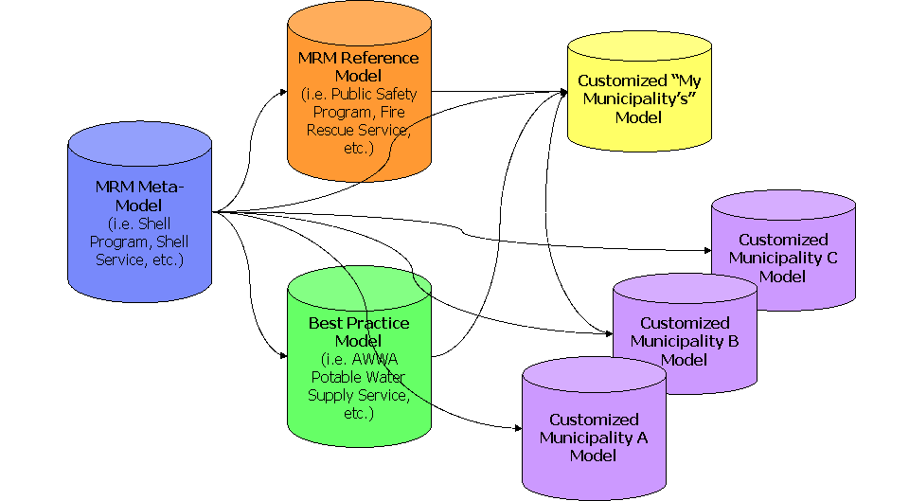
Additional investigation is required to generalize plugin requirements to support municipal programs and services
MRM v2 Components:
Note – MISA Team has launched a project to review and simplify the Meta Model. Also discussions underway to align with the CGRM project. Will need to agree to a date when the Meta Model deemed as “authoritative” to be used for the pilot.

Slide 14
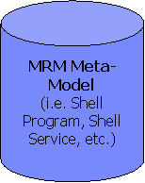
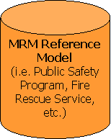
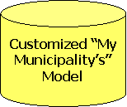
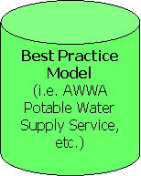
Revised target MISA Delivery Platform Governance and Operations
Governance (MRM and Delivery Platform)
Subscriber (Municipalities) Lifecycle Management
Collaboration
Workspace
Design & Modeling Tool Provision
(Image & License Mngt)
Search, Query, Reporting, Import & Export Capabilities
Application & Infrastructure Delivery Platform & Operations (eSolutions)
Municipality Platform Governance and Operations
My Municipality Model Management
Administration
Project
Support
Arch & Model
Review Board
Meta
Modeler
Reference
Modeler
Strategy & Planning
IT Architecture
& Design
Business Operations
Organization &
Process Optimization
Strategic
Intent & Priority
Business
Architecture
Enterprise
Architecture
Executive
Dashboard
BI & Analytics
Organization
Modeling
Application/
Service
Architecture
Technical
Architecture
Solution
Architectures
Mission
Performance
Financial
Performance
Process
Modeling
Transition &
Roadmap
Build &
Test
Operational
Performance
Process
Simulation
Municipality Collaboration, Design & Content Mngt Platforms

Slide 15
MRMv2 Program PROJECT Organization and Governance Structure to be revised to support the go forward role of MISA as a provider of MRM v2 and Collaboration Workspace
MISA / ASIM Canada
MISA Ontario
Steering Committee
NOTE: Chartwell Acquired by KPMG in March 2009
Program Director
Program Advisor
Chartwell
MRM V2 – Program
Program Manager
Design Review Group
Software and Website
Program
Fund Raising
Program Sustainment
Marketing & Communications
Training
Implementation
Lead Municipality
Project Manager
Project Manager
Project Manager
Project Manager
Operating and Support Environment.
Data Population
Software Vendor
Chartwell
Test Municipalities
Project Manager
Project Manager
Note – MISA has a project underway to evaluate the governance model for the future .

Slide 16
Summary of the tool assessment given the requirements identified during the ITR

Slide 17
Option 1: Tools currently in use for pilot
Rational Software Architect (Modeler) for meta model
  SysML model with export to ReqPro requirement types
  Currently: 2 floating licenses
ReqPro for reference and instance municipal models
  Matrix builder for editing relationships between entities
  Model compare
  Currently: 4 floating licenses
Rational Requirements Composer (RRC) to elaborate reference and instance models
  Rich text
  Business process, organization and use case diagrams
  Currently: 3 authorized users within server license
Lotus Quickr for collaboration
  Places setup for each municipality
  Ability to collaborate for review, approval and action on municipal transition initiatives
  Focus mostly on strategic planning in this phase

Slide 18
Pilot work to date has emphasized Reqpro in defining metamodel and reference models
Rational System Architect XT (web based)
Note: Rational Software Modeler (RSM) is a subset of Rational Software Architect (RSA)

Slide 19
Issues raised given current tool list (June 25 email)
Tool Challenges
  Complex, licensing initial tool and project setup
  Challenges running rich client apps in a WAN
  Limited or manual integration between tools
  Meta-model and instance model
  Model and rich text & graphics
  Model and collaboration environment
  Lack of data validation on import using the matrix builder
  Limited support for model diagrams and/or model comparison
  Limited Reporting, Querying and Scripting
  Export and publish capability
Solution Issues
  How to export from MISA repository into a Municipality’s design & development environment
  Making the MISA models actionable
  Integration with down-stream Model-Driven solutions design, implementation and deployment
  Move to load and save capability instead of export/import
  Reporting capabilities
Process Enablement
  How to create initial municipal model
  Import CSV file from existing assets
  Use matrix editor to edit relationships
  Frameworks for model development and use
  Supporting guidebooks
  How to create a municipal instance by merging multiple reference models
  Need to support multiple reference models (e.g. water, transport, police, transit etc.)
Governance Challenges
  Lifecycle management of meta model and reference model
  Structure of the reference model given variation in service offerings by Municipality
  Need to support multiple reference models (e.g. water, transport, police, transit etc.)
  Lifecycle management of the municipality instance models and initial “on boarding” of subscribers
  Data validation at source
  Development and customization support needs including ongoing IT Service & Security Management
Notes:
See SDW Technical Challenges.doc

Slide 20
Emerging needs identified through the ITR process (beyond current scope of the pilot)
Interface and tools required to support variety of role types including a non-technical user
Need for multi-classification for more flexible organization, easier search - consider
Need for financial planning and reporting integrated with dashboard capability
Need for easy modification, lifecycle management and compare/merge of models
Need to connect policy, metrics to operational systems for feedback
Balance functional and usability with a shared cost model
IT Service Mngt and Security integration
Low entry cost for municipalities
Support for centralized License and Image management by MISA
Help and training support for municipality roles
Tool requirements will vary by municipality
Some municipalities need modeling tool, others just need access to the data to incorporate within own tools
Support both Business and IT planning including
Upstream Strategic Planning (what to do with the municipal models)
Downstream Connection to IT architecture (for solution design/development)
Business Analytics, Executive Dashboards and Business Intelligence
Notes:
Issues taken from various MISA presentations

Slide 21
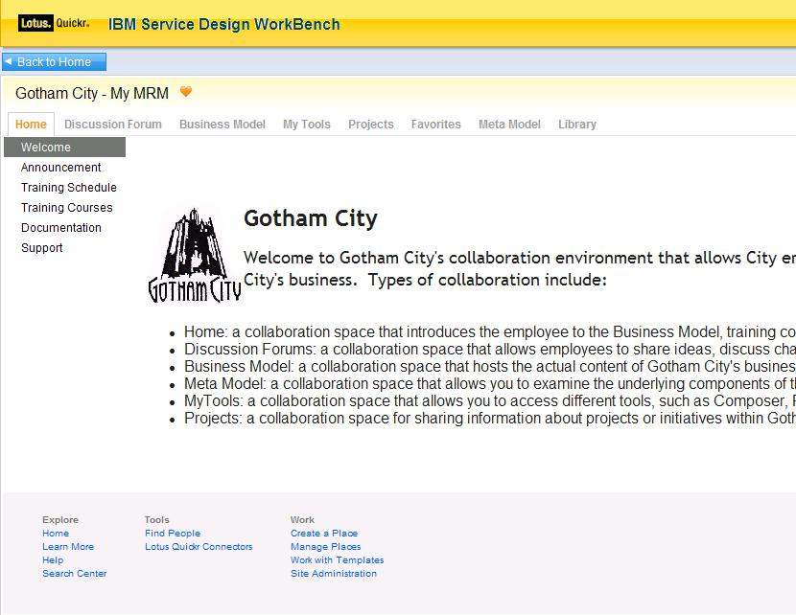
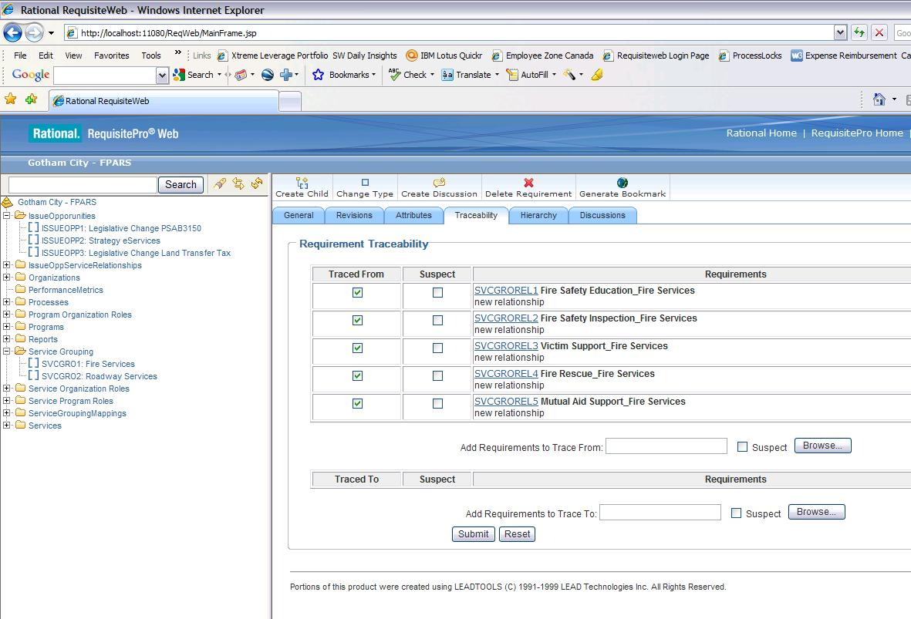
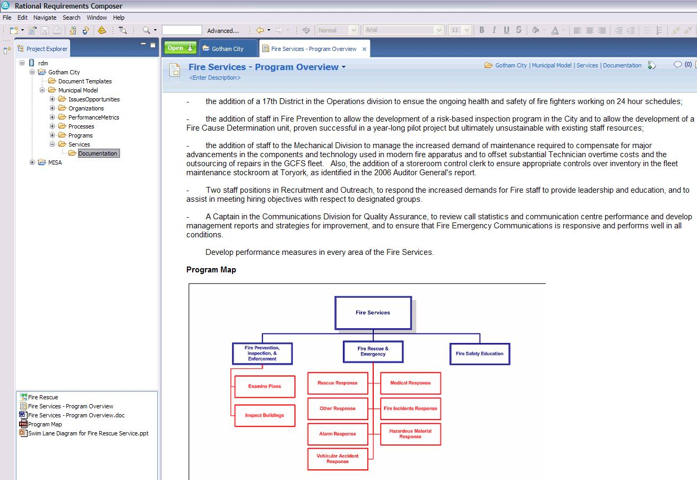
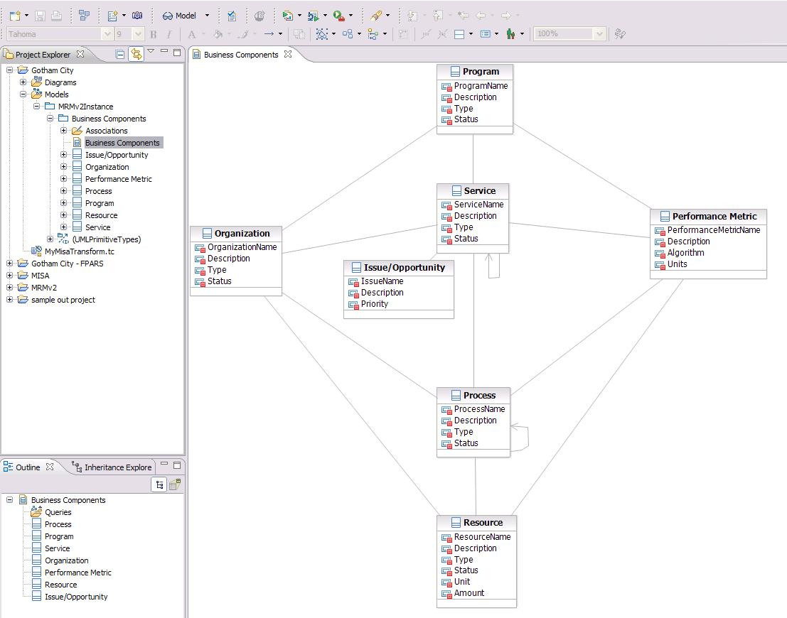
SDW Option 1: Evolve Current Tooling Architecture
Business User
Business Analyst
Meta Modeler
Rational RequisitePro
Rational Requirements Composer
Lotus Quickr
Rational Software Modeler
ReqPro
  Create & manage business components
  Build relationships between components
  Query business components
  Compare business components in one municipality or across municipalities
  Import/Export business component matrices
RRC
  Elaborate on business components with documents, BPM diagrams, UC diagrams
Review business component content published from ReqPro, RRC, RSM
Collaborate – forums, wikis
Create and extend MRM meta-model
Compare meta models (versions of one municipality or across municipalities)

Slide 22
SDW Option 1: RSM for metamodelers, ReqPro for business analysts
Rational System Architect XT (web based)
Note: Rational Software Modeler (RSM) is a subset of Rational Software Architect (RSA)

Slide 23
SDW Option 1: Assessment
Address install, update, licensing with scripts or VM image clone
Address usability issues with convenience menu items and integration scripts
  Hide import/export with “edit/save” where possible
Solution is available for pilot now
But pilot solution architecture misses extended functionality that comes by following IBM's strategic product directions
  Doesn’t address lifecycle management
  Doesn’t support strategic planning
  Relies on the development of customized scripts that will require on-going support & maintenance
  Not well positioned for EA or solution design/delivery
  High dependency on tooling that is not designed for modeling

Slide 24
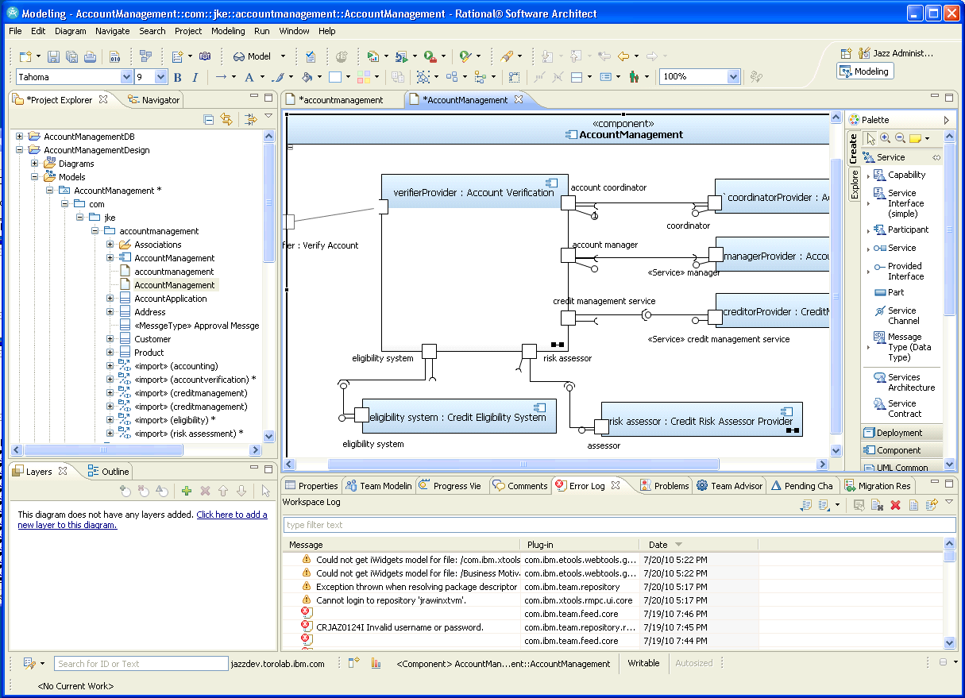
SDW Option 2: Tooling Architecture based on RSx (RAD+RSM)
(Model Driven Development - Smarter Architecture & Engineering Solution)
Business User
Business Analyst
Meta Modeler
Lotus Quickr
Rational Software Modeler, RAM, RPE, BIRT, Insight, (in future CAM)
Rational Software Modeler
  Create & manage business components
  Build relationships between components
  Query business components
  Compare business components in one municipality or across municipalities
  Import/Export business component matrices
  Elaborate on business components with documents, BPMN diagrams, UC diagrams
  Leverage the extensibility of Eclipse
Review business component content published from RSx
Collaborate – forums, wikis
Create and extend MRM meta-model
Compare meta models (versions of one municipality or across municipalities)

Slide 25
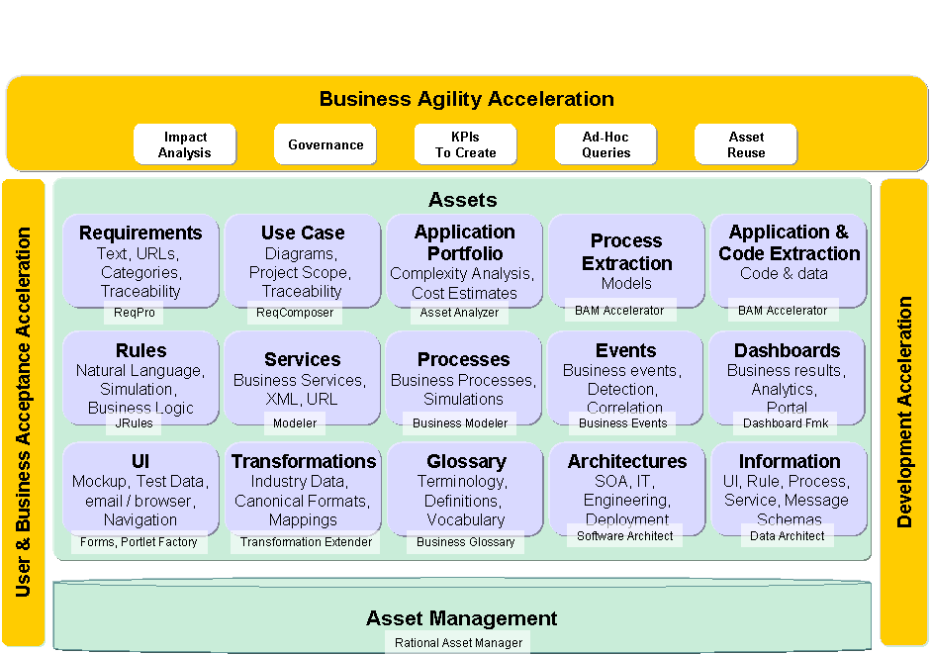
Recent IBM announcement - Smarter Architecture & Engineering Solution to support Model Driven Development
Notes:
ReqPro & Requirements Composer
This “Must” …
Links to other assets
Asset Management Repository
Taxonomy
Search
Report
Governance
Software Architect
Business Architecture
UML
Traceability
Modeler
Business Processes
Publishing Server
Simulator
Business Rules
Externalize Logic
Rules Server
Forms
Email UI to Users
Integrate with Web 2.0 and Portal
Portlet Factory
Assemble Forms and Portlets
Business Events
What happens over time?
Visual Portlets
Business Spaces
Integrates UI for Business Architecture
Runtime Results
Iwidgets
Data Architect
Logical Information Model
Asset Analyzer
Legacy analysis
Complexity Analysis

Slide 26
SDW Option 2: Tooling Architecture based on RSx
(Smarter Architecture & Engineering Solution)
Rational System Architect XT (web based)

Slide 27
SDW Option 2: Assessment
Refactor meta-model as a UML profile
Generate tooling UI from UML profile
Apply UML profile for municipal instances
  Can exploit SysML and/or SoaML for services modeling, BMM for business motivation and strategy
  BIRT and Insight for reporting
  Similar solution for matrix/spreadsheet editing
  Direct support for diagrams and rich text documents
  Integration with WebSphere Business Modeler
Mostly single tool solution but with limited Web UI
  RSx 8 and CAM 3.0 provide read-only web access and review, markup and commenting
Good solution if downstream IT development and deployment is primary value proposition
  Focus on Model Driven Development NOT Strategic Enterprise Planning

Slide 28
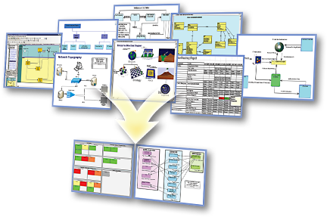
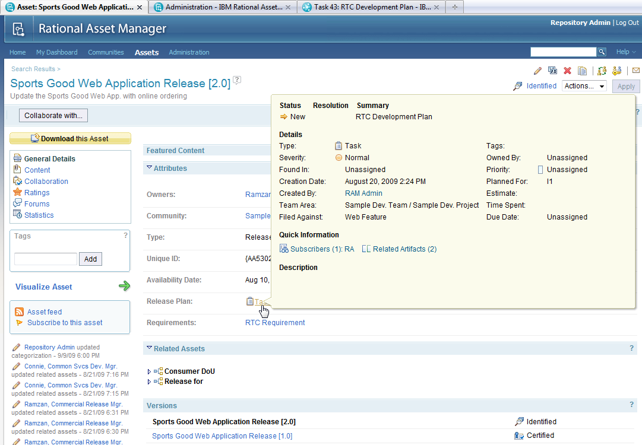
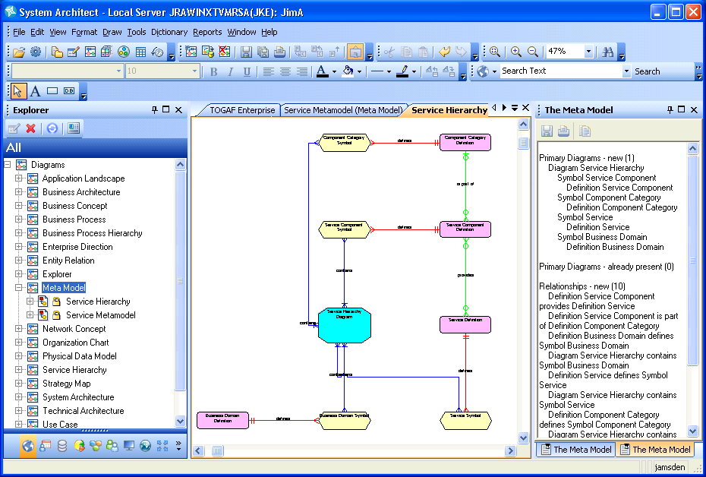
SDW Option 3: Rational System Architect (SA) for Strategic Enterprise Planning
Business User
Business Analyst
Meta Modeler
System Architect, SA/XT, RAM, RPE
System Architect Extensibility
Lotus Quickr
  Create & manage business components
  Build relationships between components
  Query business components
  Compare business components in one municipality or across municipalities
  Import/Export business component matrices
  Elaborate on business components with documents, BPMN diagrams, UC diagrams
  Web Interface (SA/XT)
Review business component content published from SA
Collaborate – forums, wikis
Create and extend MRM meta-model
Compare meta models (versions of one municipality or across municipalities)

Slide 29
SDW Option 3: Rational System Architect (SA) based
Rational System Architect XT (web based)

Slide 30
SDW Option 3: Assessment
Supports Enterprise Strategic planning not just Model Driven Development
Meta-model and models are in a single tool
Supports lifecycle management through workspaces
Integrates with Focal Point for strategic planning
Integrates with Cognos for Business Intelligence
Supports explorer, data forms, diagram and matrix views
SA/XT provides Web interface with limited editing capability
Powerful, flexible query mechanism, explorer diagrams and reporting
Highly customizable for stakeholder viewpoints
Supports model compare/merge
Provides support for enterprise architecture including business and IT architecture for solution design
Good solution if strategic planning is the primary value proposition
Future support for semantic web
Integrated Guidebooks and help
Notes:
+ SA has a rich client UI, and a Web UI using SA/XT that also supports model editing
+ SA supports integrated explorer, data entry form, diagram and matrix views on model data as well as free-form views
+ SA provides rich, extensible matrix views and additional views can be created by end users in support of particular stakeholder needs
+ SA is highly customizable even by end users (for opportunistic metamodel extensions)
+ SA has a powerful, flexible query mechanism
+ The supporting tool set is resulting in the installation of less tools (SA and SA/XT)
+ Information is integrated into a single repository accessed by different tools reducing lifecycle management burden and costs
+ Lifecycle management is supported by workspaces and compare merge of model content
+ Information redundancy can be managed as needed
+ The MRM business motivation and strategy, and business architecture parts of EA can be easily extended or integrated with other content and capabilities to support the rest of the EA (application, data and technical architectures) for the next phase of use cases
- Editing the metamodel with SA USERPROPS is not as easy as editing a UML model. This may be improved in 11.4.1 with the introduction of a metmodel editor extension to visually create the metamodel extensions. (That capability may be available for internal use now).
+ Metamodel extensibility includes support for explorers, forms, matrixes, diagrams and reports, not just the metamodel classes
+ SA has a number of different reporting options that can be used
+ SA/XT can be integrated with Quickr to provide collaboration on live MRM data, not just published, potentially stale data
- SA rich client UI may not be appropriate for many business analysts and SA/XT has limited editing capabilities
+ SA integration with Focal Point would provide a capability to objectively analyze different MRM project alternatives
+ Some elements of the existing SA TOGAF and/or TeamSD metamodels could be used to enhance and extend the existing MRM metamodel and tools, as well as address more of the MRM business use cases.
- No support for sketching and storyboards directly in SA

Slide 31
Addressing the Issues
Issue | Addressed By
Complex, licensing initial tool and project setup | Reduction in number of tools. SA replaces RSM, ReqPro and RRC
Challenges running rich client apps in a WAN | Same problem with all options. SA runs in Remote Desktop Connection with floating license
Limited or manual integration between tools Meta-model and instance model Model and rich text & graphics Model and collaboration environment | All models in SA. SA extensibility used to update metamodel. SA and SA/XT used to view and edit models. Uses SA browser, definitions, diagrams, matrices, explorer diagrams
Lack of data validation on import | Eliminate as much as possible import/export as a means of integrating tools
Limited support for model diagrams | SA has support for many standard diagrams, explorer diagrams (from reports) and can have custom diagrams
Limited Reporting, Querying and Scripting | SA supports queries, HTML and Office reports, SA Publisher, Insight and Cognos reporting, and RPE

Slide 32
Addressing the Issues (cont.-)
Issue | Addressed By
Interface suitable to different stakeholders | SA rich client for business architect, SA/XT for business architect and user, Quickr for collaboration
Support for flexible classification | SA supports categorization of model elements, and/or use RAM
Strategic Planning | SA integration with Focal Point provides: Project Portfolio Management Strategic alignment with business objectives Assessment of costs, risks, NPV, time to value Project roadmaps and resource allocation
LIfecycle Management | SA has versioning for definitions, and workspaces for different work streams. Supports compare and merge to manage changes. RAM for asset management and governance
Cost | Incremental difference in cost for each solution option. Actual cost depends on potential use of Cloud subscription model. Needs further investigation
Availability | Existing solution would need to be migrated to chosen option

Slide 33
Proposed Next Steps from July 21 meeting
Recommendation maintain current Quickr deployment for collaboration
  Misa team to validate structure and configuration parameters to support the pilot
Recommendation by the MISA Team to further investigate Option 3 for the September pilot
  Misa team to finalize the Meta Model to be used for the pilot
  Misa team to finalize the Reference Model (s) to be used by the pilot
    May wish to include multiple reference models to test merge capability
  IBM Team to determine scope of work and estimate of effort to migrate the current Meta Model and Reference Model into Rational System Architect from the current pilot
    Review the Ontario Public Service GSDC System Architect deployment & Meta Model (July 22)
    Develop revised target solution architecture and blueprint
    Estimate effort to support target Pilot start date September 2010
    IBM to determine migration of current licenses to Rational System Architect option
  Team to investigate what other tools maybe required given measurement and reporting functional requirements
    For example the addition of Rational Focal Point, Insight and/or Web based Rational System Architect XT
Recommendation investigate further alternate delivery model for access to tools
  IBM to arrange a workshop and presentation of the Cloud Burst toolkit and Rational Asset Manager to support potential for future tool provisioning based on an desktop image catalog
Recommendation to investigate opportunity to build MISA Industry Plug-in
  Initial recommendation is to investigate support for both modeling & planning tools and Business Intelligence/Analytics tools
IBM Team to talk with Jim Alexander regarding target governance model

Slide 34
Appendix

Slide 35
MISA Meta Model Business Components
Entities and Attributes
  Program=PG
  Service=SV
  Organizational Unit=OU
  Process=PR
  Performance Indicator=PI
  Project=PJ
  Outcome=OC
  Need=NE
  Target Group=TG
  Resource=RE
  output=OP
  Location=LC
  Change Driver=CD
  Business Process=BP
Relationships
  Project Program Scope=PJPG
  Program Outcomes=PGOC
  Program Services=PGSV
  Program Accountabilities=PGOU
  Program Hierarchy=PGPGHI
  Program Performance=PGPI
  Program Impacts=PGCD
  Service Level Agreements=SVSVSLA
  Service Hierarchy=SVSVHI
  Service Processes=SVPR
  Service Outputs=SVOP
  Service Accountabilities=SVOU
  Service Performance=SVPI
  Service Impacts=SVCD
  Project Service Scope=PJSV
  Client Set=OPOC
  Process Impacts=PRCD
  Process Resources=PRRE
  Process Hierarchy=PRPRHI
  Process Performances=PRPI
  Process Responsibilities=PROU
  Process Outputs=PROP
Relationships cont.
  Process Sequence=PRSQ
  Project Process Scope=PJPR
  Business Process Composition=BPPR
  Resource Hierarchy=REREHI
  Resource Impacts=RECD
  Resource Performance=REPI
  Resource Authorities=REOU
  Project Resource Scope=PJRE
  Project Organization Scope=PJOU
  Organizational Hierarchy=OUOUHI
  Target Group Outcomes=TGOC
  Need Outcomes=NEOC
  Output Composition=OPOPHI
  Needs Hierarchy=NENEHI
  Target Group Hierarchy=TGTGHI
  Resource Location=RELC
  Service Location=SVLC
  Organization Location=OULC
  Outcome Hierarchy=OCOCHI
Municipal Reference Model (MRM) Version 2 (V2) – Release 1 Business Use Cases, Tasks, Operations, Features
and Meta Model Specifications V19, December 2009

Slide 36
Government of Ontario GO-ITS Standard 56 V 1.5 (May 2010) - Artefacts
Resource Type
Line of Business Profile
Program
Service
Program Profile
Location Type
Geographical Area Type
Party Type
Role Type
Target Group Type
Event Type
Cycle Type
Goal
Need
Mandate (Program)
Strategy
Target Group / Need Cross Ref
Program/Service Cross Ref
Conceptual Data Model
Information Model
Semantic Model
Fact and Dimension Matrix
Interface Data Requirements Document
Service Life Cycle
Business Function Model
Service Integration and Accountability Model
Service Profile
Business Process Model
SOA Service Description Profile
Business Network Model
Governance Model
Organization Chart
State Transition Diagram
Business Scenario
Service Objectives
Performance Matrix
Business Rule Source
Business Rule Profile
Program Logic Model

Slide 37
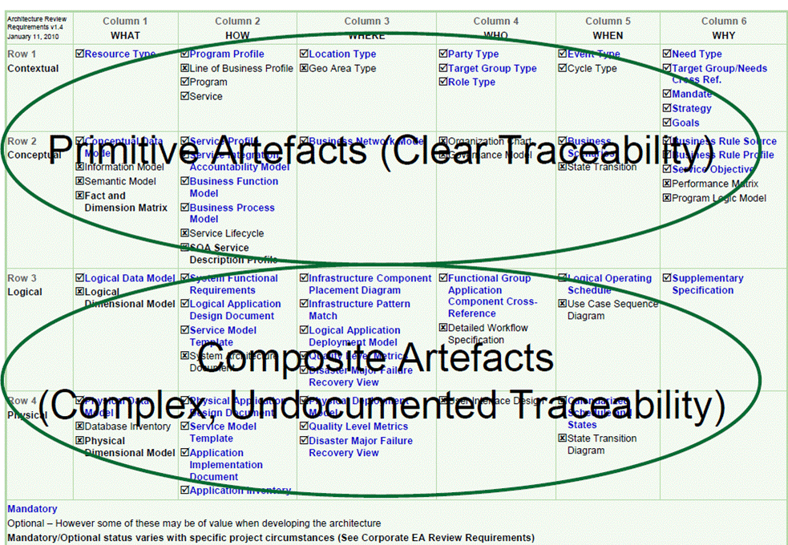
Government of Ontario GO-ITS Standard 56 V 1.5 (May 2010) - Artefacts

